Slide 1



Literacy
This half term we will focus on three key texts: Handa’s Surprise,What The Ladybird Heard and Tyrannosaurus Drip. Each story will be explored in depth over one or two weeks, allowing children to learn and use new vocabulary, songs, and story language linked to the text. Through regular book talk sessions, children will develop their communication and language skills by listening attentively, responding to questions, and sharing their ideas.
Mark making opportunities will be closely linked to our focus texts. Children will continue to practise letter formation in Phonics lessons and beyond. They will work on learning letter from their name. They will also build confidence in recalling and retelling stories. Children will become confident communicators and early writers while fostering a love of stories.
Mathematics
This half-term we will continue to learn new skills during daily inputs. We will develop these new concepts further during focused adult-led group times. We will revisit prior learning and continue with the days of the week and months of the year. The provision in our maths area will also support children to apply their new knowledge. The children will learn:
Numerals up to 10.
Simple addition.
Subtraction.
Doubling.
Sharing.
Directional Language.
Nursery
Summer 1
Animal Safari
Personal, Social and Emotional Development
We will continue to provide opportunities for children to develop a positive sense of themselves and others, to form positive relationships and develop respect for others, to develop social skills and learn how to manage their feelings, to understand appropriate behaviour, and to have confidence in their own abilities. We will continue to follow our daily routine, encouraging the children to take turns, share answers and be actively involved in their learning.
Physical
We continue to provide daily physical activities both indoors and outdoors. We will closely work with children to build the fine motor skills needed for early writing. Through activities such as mark making, threading, cutting, dough disco, and finger-strength games, children will develop hand strength, control, and coordination. These skills support correct pencil grip and letter formation. We will practise forming letters carefully and confidently, helping children build the foundations for mark making.
Key Dates:
Monday 4th May- Bank Holiday
Tuesday 19th May- Class Photographs
Wednesday 20th May– Trip to White Post Farm
Monday 24th May - Half Term Week

Slide 2

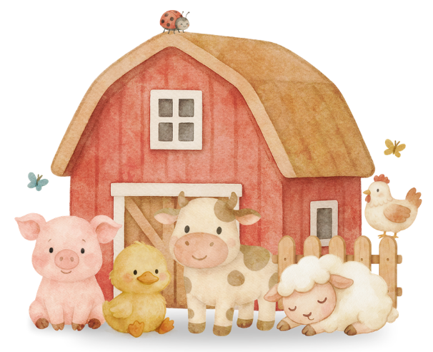

Communication and Language
This area of learning consists of listening and attention, understanding and speaking. We have lots of opportunities for discussions and will encourage this during adult-led group times and snack times. We will play alongside children during provision and model language. We will plan activities to develop listening and attention skills.
There will be interventions in place for any children that require additional support with communication and language.
Reading Books
Book bags will continue to be returned to school every Thursday and returned to you on the Friday. Your child will still bring a shared reading book. This is for you to share together. The children can develop their ability to talk about the pictures, ask questions and join in repeated phrases. The children love sharing books with their adults and siblings. It promotes a love of reading and responsibility.
Understanding the World
This half term we will be focusing on animals and habitats. We will be able to explore different animals. The children will have the opportunity to consolidate their learning on our class trip to the farm.
Expressive arts and Design
We will develop expressive arts and design through imaginative play. We will have small world and role play resources for the children to access. We will enhance the provision to link with our topic and to meet the needs and interests of children. We will create pictures of ourselves and our families. We will also make art linked to our key texts.
School Uniform
Uniform Expectations: We will continue to uphold expectations for school uniform, including: A navy blue jumper or cardigan with or without the school logo; grey trousers, skirt or shorts; white or navy-blue polo shirt with or without the school logo; plain white, grey or black socks or plain grey tights; Plain black trainers or school shoes.
Please ensure uniform is clearly marked with the child’s name.
We will have a range of materials available for the children to explore independently on a daily basis. The children will continue to learn how to use our resources effectively, including how to look after the provision. They will have access to arts, crafts and musical instruments.

Slide 3


