Slide 1


English
In our English lessons, we will be focusing on lots of familiar stories and how to write sentences from the stories. We will be developing our stamina for writing longer pieces this half term. We will be learning how to read and write compound words such as bedroom, popcorn, football and learning how to use them in our writing. We will recap our learning about suffixes and prefixes.
Mathematics
The children will be learning how to count in 2s, 5s and 10s including how to write these as multiplication and division number sentences. We will also be learning some fractions (whole, half and quarter). The children will also learn about money and how to complete simple addition and subtraction using money.
Physical Education
Our PE lessons will be twice a week on a MONDAY and TUESDAY this half term. Children will need to come to school wearing their PE kit which consists of:
Library
Our library day will be on a Monday. If children wish to change their book then they can bring it on a Monday morning along with their book mark and hand it to Mrs Millington. They are welcome to keep their book for more than one week. Levelled reading books will also be changed on a Monday.
Year 1
Summer 1
Plain navy blue t-shirt with or without the school logo (no branded logos)
Plain black shorts, leggings or cycle shorts (no branded logos)
Plain black tracksuit bottoms (no pattern, branded logos etc)
Plain navy-blue sweatshirt (no hood, no pattern, no branded logos)
Plain black trainers that are suitable for outdoor sport. All soles and logos must be black.
Sun cream when the weather is warm
Sun hat
PSHE
In PSHE, we will be learning about the wider world. This will include learning about money, rule, the difference between want and need, respect for others and being part of a wider community. We will be thinking about transitions that happen in our lives.
Science
This half term, the children will be learning about animals including humans. They will learn how to classify animals, how to recognise the features of animals within each classification, the basic structure of the human body and about carnivores, omnivores and herbivores.
Please label all clothes clearly with
your child’s name.

Slide 2

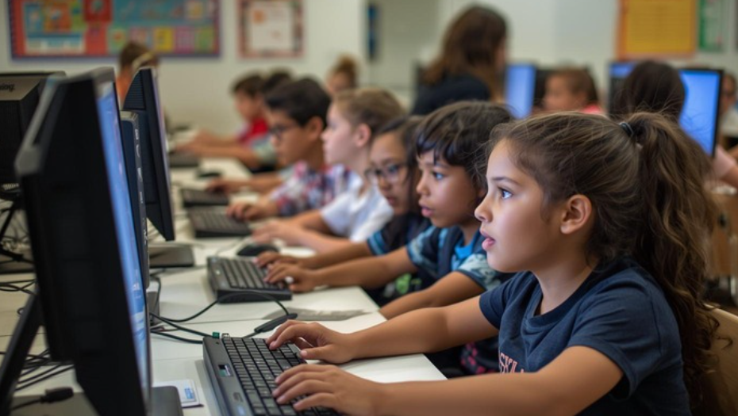
Important Dates-
Monday 4th May- Bank Holiday (school closed).
W/C 8th June- Phonics Screening Checks.
Tuesday 23rd June- School Trip to Cannon Hall Museum – Details on Ping
Computing
In our computing lessons this term, we will be learning about what algorithms are and how we can follow them to carry out simple tasks. The children will also create their own algorithms using the program Scratch, helping them to develop their problem-solving skills and understanding.
Uniform Expectations: We will continue to uphold expectations for school uniform, including:
A navy blue jumper or cardigan with or without the school logo; grey trousers, skirt or shorts; white or navy-blue polo shirt with or without the school logo; navy and white checked summer dress, plain white, grey or black socks or plain grey tights; Plain black pumps, trainers or school shoes to be worn inside the school building. Shoes with coloured laces or soles will not be accepted.
Please also ensure that all hair accessories are in line with the school uniform colours. Nail varnish, jewellery and watches are not permitted.
Art
In our art lessons this term, we will continue exploring the work of Piet Mondrian. The children have already learned about his distinctive drawing style, and we’re excited to build on this by exploring his painting techniques. They will also have the opportunity to develop their skills using powder paint.
To help protect uniforms, you may wish to send your child in with an old, oversized T-shirt to wear during art lessons. If you choose to do so, please place it in a bag labelled with your child’s name. These can be kept in lockers and will be sent home at the end of the half term.
Outdoor Learning
This term, the children will be taught outdoor learning by Mrs Townend. This will be on a Wednesday afternoon. The children will need a sun hat if the weather is nice and if the weather is wet then they will need a raincoat. This lesson takes place in Walt’s Wood within the school grounds.
As the weather gets warmer, please apply suncream before school and send a sun hat that is clearly labelled with your child’s name.

