Slide 1


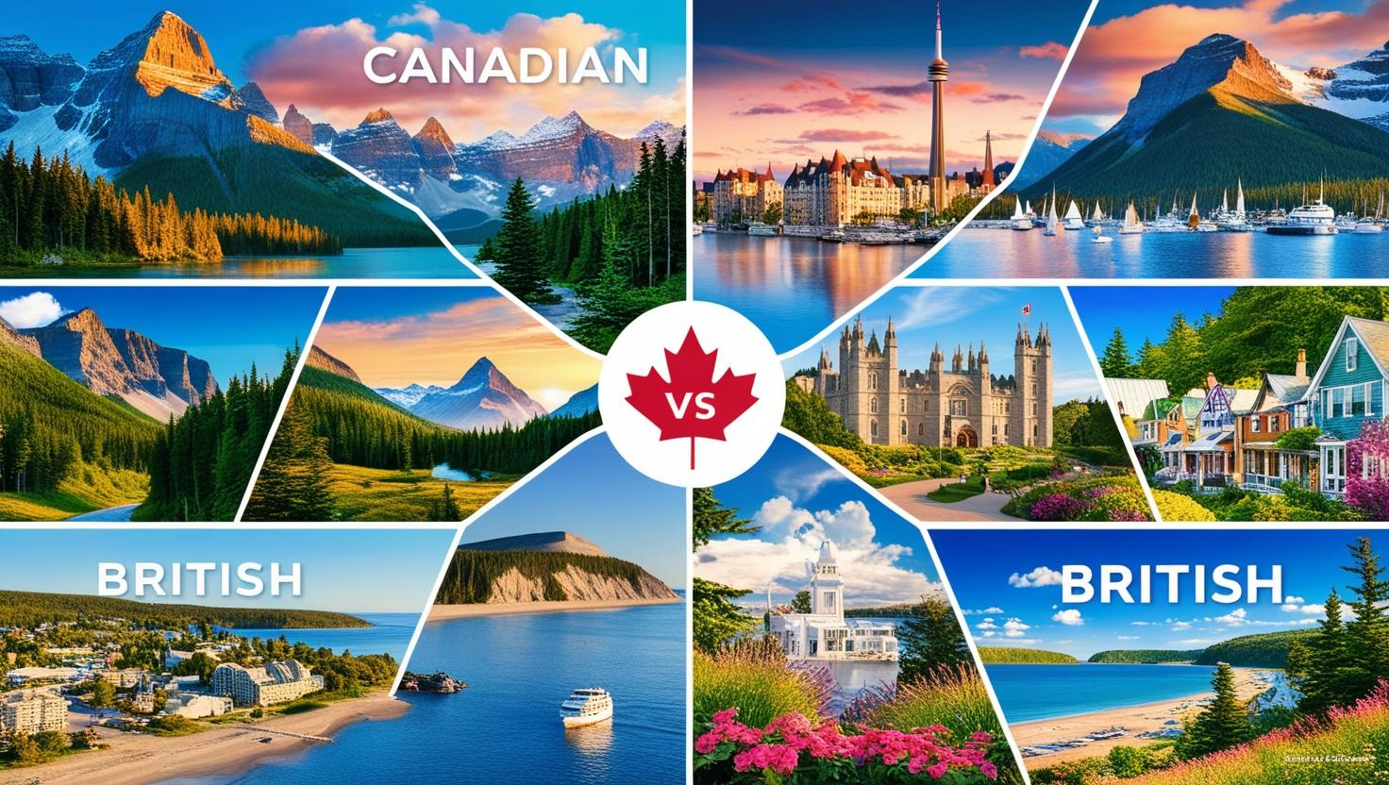




English
Geography
In Geography this half term the children will be focusing on place knowledge. They will learn about the lifestyles of people in the UK and in Canada.
During English this half term, the children will be writing an article as well as publishing some poetry.
DT
In design and technology the children will be working collaboratively to create a nightlight. The children will complete a design process and will be tasked with selecting tools and materials to create their final design.
Mathematics
The children will be focusing on decimals during this half term. They will learn about decimals as fractions, on a number line and on a place value chart. For the last week of term the children will be focusing on money. They will learn how to estimate and calculate with money.
Year 4
Summer 1
Computing
During computing this half term, the children will be learning to evaluate digital content using word as their main software.
Spanish
This half term in Spanish the children will learn about Spanish numbers, Spanish greeting and locational knowledge.

Slide 2

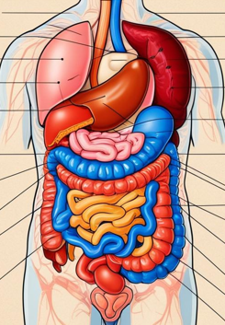
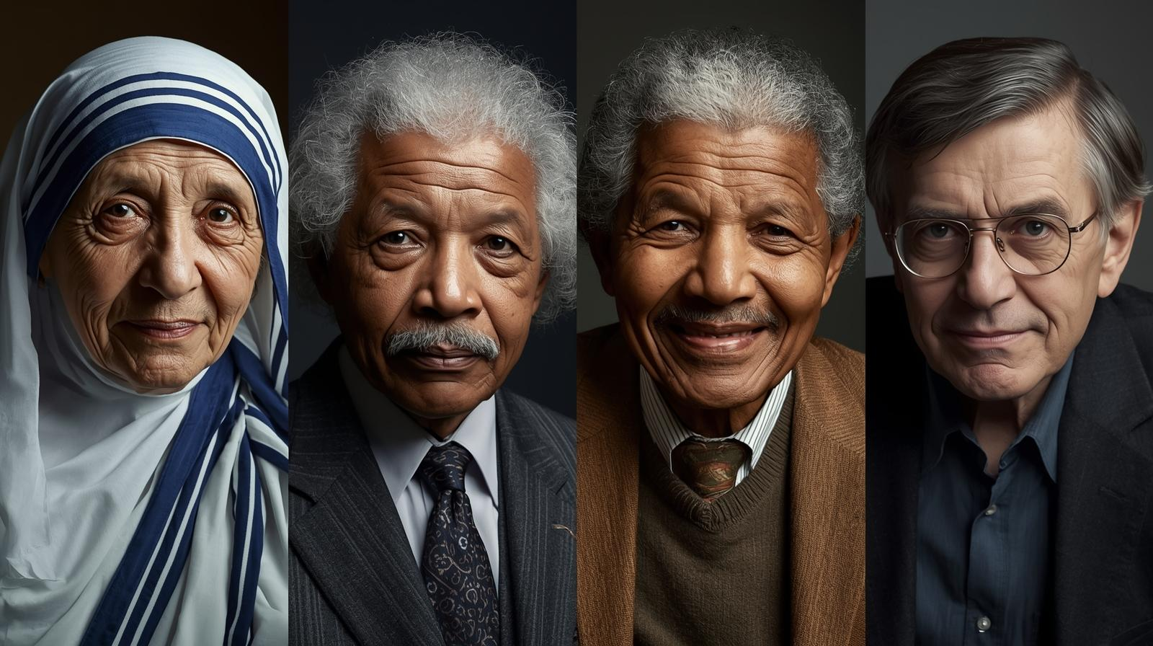
PSHE
This half term we will be focusing on transition. We will focus on the different transitions the children may face throughout life as well as the transitions that they have already faced.
PE
This half term the children will take part in Netball with Mr Goddard and Tennis with Miss Rawson.
Monday, Tuesday, Friday
Uniform Expectations: We will continue to uphold expectations for school uniform, including: A navy blue jumper or cardigan with or without the school logo; grey trousers, skirt or shorts; white or navy-blue polo shirt with or without the school logo; plain white, grey or black socks or plain grey tights; Plain black pumps, trainers or school shoes for inside the school building and a sensible shoe or boot of their choice to play outdoors in.
Wednesday, Th
PE Kit should include: Plain navy-blue polo shirt with or without the school logo; plain black shorts, leggings or cycle shorts; plain black tracksuit bottoms; plain black tracksuit bottoms; plain navy-blue sweatshirt and plain black trainers that are suitable for outdoor sport.
Please ensure uniform is clearly marked with the pupil's name.
Science
This half term in Science, the children will learn about humans and animals. This includes learning about the digestive system, the structure of teeth and food chains.
Year 4
Summer 1
Religious Education
During RE this half term, the children will continue to explore why people choose to follow inspirational leaders.

