Slide 1



Class Novel
This term our class novel will be ‘The Final Year’ by Matt Goodfellow. This book follows the story of a young boy who is going into Y6, dealing with a failing friendship, an ill younger brother and his own mental demons.
Computing
This half term, children will continue developing their understanding of algorithms and debugging using Micro: bits as part of their computing lessons.
Mathematics
Children will be focusing on algebra, ratio and statistics during this half term. They will then be focusing on SATs revision in the remaining maths lessons.
If you would like to help at home, encouraging your child to focus on their times tables and access SATs Bootcamp will be of benefit.
SATs dates for your diary:
Monday 11th May – Spelling, punctuation and grammar
Tuesday 12th May – Reading
Wednesday 13th May – Arithmetic and reasoning
Thursday 14th May – Reasoning
Thursday 14th May 1:30pm – SATs picnic
Year 6
Summer 1
English
This half term we will have a SPaG focus each day during English lessons.
SATs breakfast
From Monday 11th May – Thursday 14th May, we are starting the day at 8.00am with a special Year 6 Breakfast Club. It is free! We want to encourage ALL children to attend so they can spend time with friends and prepare for the tests. The children can enter school through the Y6 fire door for the breakfast on these mornings. On the Thursday breakfast session, there will be the offer of a sausage or bacon sandwich if the children wish.
Physical, Social, Health Education (PSHE)
This half-term we will continue to focus on Health and Wellbeing, linked to: relationships that they may form, online relationships and how to get support with these and also a recap on puberty and changes to their body.
Physical Education
The children will learn skills linked to tennis on a Wednesday afternoon and will focus on netball with Mr Goddard on Thursday afternoons.
MFL - Spanish
Children will continue building on their learning from Year 5 with a focus on greetings, locational knowledge, colours and pets.

Slide 2
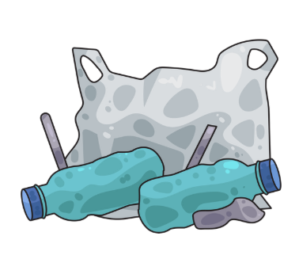

Art
Year 6 will be beginning their work on ‘sculpture’ with Mrs McCormack. They will focus on Aurora Robson who is a contemporary artist who creates sculptures and installations using plastic waste and recycled materials.
Monday, Tuesday & Friday
Uniform Expectations: We will continue to uphold expectations for school uniform, including: A navy blue jumper or cardigan with or without the school logo; grey trousers, skirt or shorts; white or navy-blue polo shirt with or without the school logo; plain white, grey or black socks or plain grey tights; Plain black pumps, trainers or school shoes.
Wednesday & Thursday
PE Kit should include: Plain navy-blue polo shirt with or without the school logo; plain black shorts, leggings or cycle shorts; plain black tracksuit bottoms; plain navy-blue sweatshirt and plain black trainers that are suitable for outdoor sport.
Please ensure uniform is clearly marked with the pupil's name.
Design and Technology
This half term our DT will link to history and science. The children will research, design, make and evaluate their own Anderson shelter.
Science
This half term in science the children will learn about electricity. They will be able to draw a scientific circuit, explain how voltage changes the brightness of a bulb and identify what renewable and non-renewable energy is.
Religious Education
In RE, children will learn about Humanism and explore how it guides people in living a good life. They will understand that humanists base their beliefs on science, evidence, and reason rather than religion, and that values such as happiness, empathy, responsibility, fairness, and equality are central to their way of life. The children will examine how humanists make moral decisions by thinking about the consequences of their actions and considering others’ feelings, often using ideas like the Golden Rule. They will also reflect on their own values, discuss what makes a happy and meaningful life, and explore how humanists try to improve the world through kindness, freedom, and respect for others.
Music
In music, we will be composing and performing our own leavers’ song, that we hope they will share with you at the Summer Aspire Event.

