Slide 1


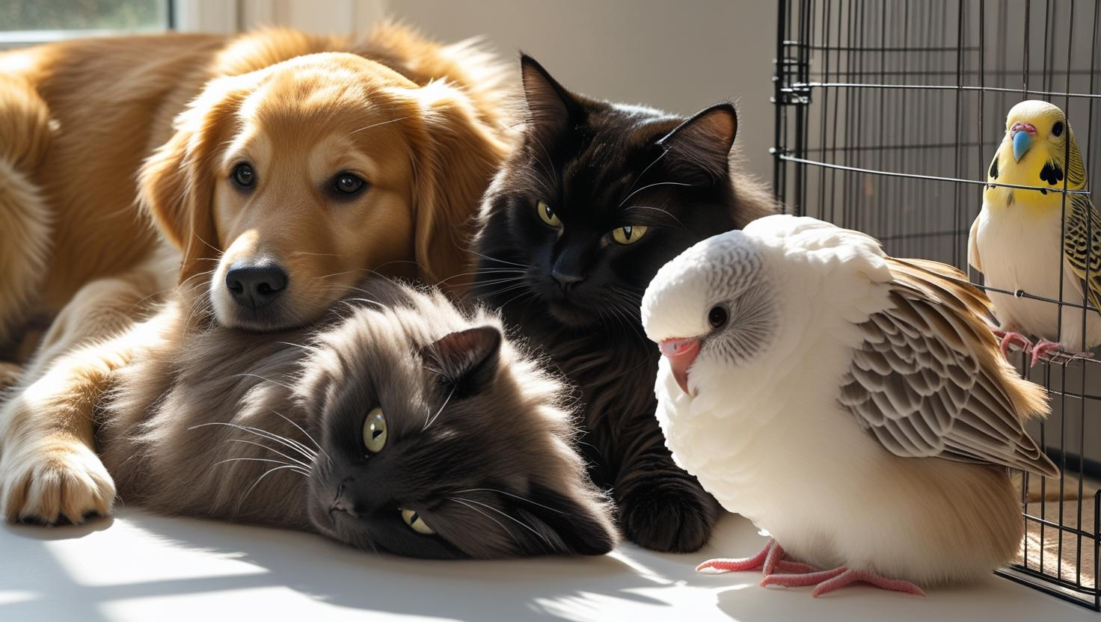



English
This half term we will be focusing on both a diary entry and a non-chronological report using videos as a stimulus.
Spanish
This half term in Spanish the children will learn about Spanish greetings, the names of pets and location knowledge.
Mathematics
Children will be focusing on angles, shapes and time this half term as well as time. The children will be learning how to identify, compare and order different angles. They will also be exploring the properties of shapes such as triangles, quadrilaterals and polygons.
Science
This half term in science the children will learn about living things and their habitats. The children will explore and group different living organisms and investigate how different habitats can change throughout the year.
Year 4
Summer 2
Computing
This half term, the children will be learning about algorithms, and what is considered important when creating a computer program.

Slide 2
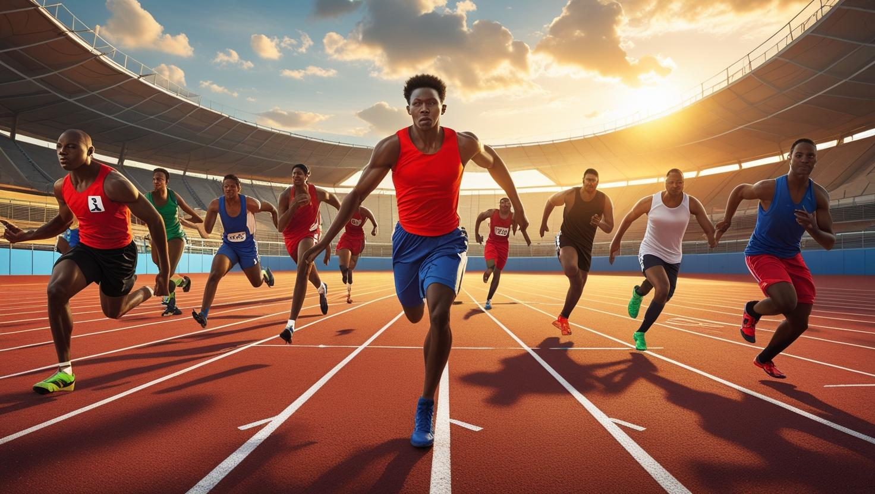


Physical Education
This half term, the children will be taking part in P.E with Miss Rawson and Mr Goddard. The children will be focusing on cricket and rounders.
Geography
In Geography the children will be focusing on human and physical geography. The children will be learning about climate zones, vegetation belts and the different types of settlements.
Tuesday Wednesday, Friday
Uniform Expectations: We will continue to uphold expectations for school uniform, including: A navy blue jumper or cardigan with or without the school logo; grey trousers, skirt or shorts; white or navy-blue polo shirt with or without the school logo; plain white, grey or black socks or plain grey tights; Plain black pumps, trainers or school shoes for inside the school building and a sensible shoe or boot of their choice to play outdoors in.
Monday and Thursday
PE Kit should include: Plain navy-blue polo shirt with or without the school logo; plain black shorts, leggings or cycle shorts; plain black tracksuit bottoms; plain black tracksuit bottoms; plain navy-blue sweatshirt and plain black trainers that are suitable for outdoor sport.
Please ensure uniform is clearly marked with the pupil's name.
Music
In music this half term, the children will be taught by Miss Alison and will be developing their recorder skills.
Year 4
Summer 2

