Slide 1




English
This half term we will be continuing to focus on fiction texts. We will be learning to write our own Myths and Legends, linked to the Ancient Greeks . We will also continue reading our first class text Groovy Greeks.
Outdoor Adventurous Activities
The children will continue to learn how to use the eight compass points and grid references to identify precise locations with Mrs Kay.
Mathematics
Children will be revisiting decimals, whilst also developing their knowledge on negative numbers, measurement and volume.
Continue to help at home by encouraging your child to recite their times tables, spellings.
Year 5
Summer 2
Art
This half-term we will develop the children’s understanding of symbolism. They will use their panting skills to add colour to create mood in their own designs. They will also use primary, secondary,
complementary and contrasting colours to create effect.
Physical Education
The children will learn skills linked to cricket with Mr Goddard on a Friday.
Computing – Using data
In Computing, Year 5 will be learning how to create questionnaires and how to analyse the results they gather. They will explore how formulas use values from other cells to carry out calculations. The children will begin to create simple spreadsheets and formulae. They will also learn how to edit and format different cells in a spreadsheet to present their data clearly and effectively.

Slide 2
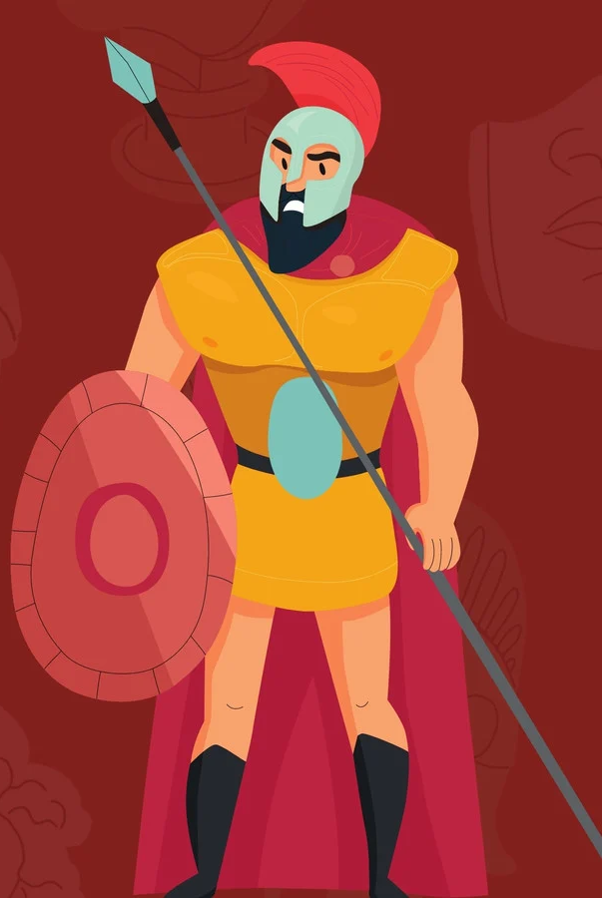
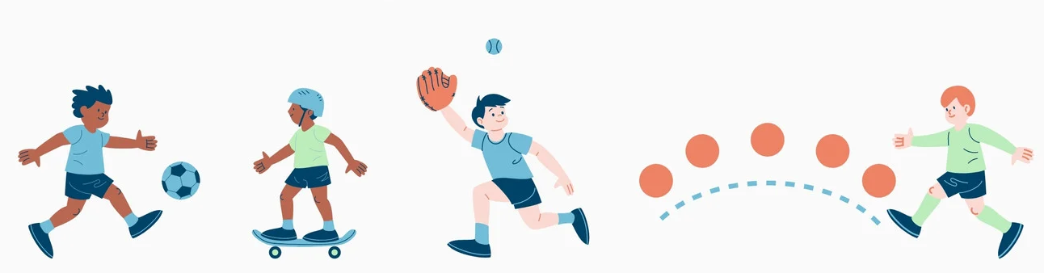
History
This half term in history, the children will continue to focus on Ancient Greeks. They will learn the origin of the dark ages, what life was like during this time period and identify how the Ancient Greek civilization impacted human development.
Monday – Thursday
Uniform Expectations: We will continue to uphold expectations for school uniform, including: A navy blue jumper or cardigan with or without the school logo; grey trousers, skirt or shorts; white or navy-blue polo shirt with or without the school logo; plain white, grey or black socks or plain grey tights; Plain black pumps, trainers or school shoes for inside the school building and a sensible shoe or boot of their choice to play outdoors in.
Friday
PE Kit should include: Plain navy-blue polo shirt with or without the school logo; plain black shorts, leggings or cycle shorts; plain black tracksuit bottoms; plain black tracksuit bottoms; plain navy-blue sweatshirt and plain black trainers that are suitable for outdoor sport.
Please ensure uniform is clearly marked with the pupil's name.
Science - Forces
This half term in Science, the children will be learning about forces and how they can impact moving objects. The focuses will be gravity, water resistance, air resistance and friction.
Design and Technology - Construction
This half term our D&T project will link to our Science learning. The children will construct their own Pneumatic devices. The children will figure out how to make their own machines move using air or gas.
Music
In music, we will be learning about Looping and Mixing. The children will use loops to create a whole piece of music, ensuring that the different aspects of music work together accordingly.
Physical, Social, Health Education (PSHE)
This half-term we will focus on transition to Year 6. The children will have a chance to discuss what the Y6 curriculum looks like, ask questions relating to SATs and learn key skills that will help them prepare for transition
to Year 6

