Slide 1

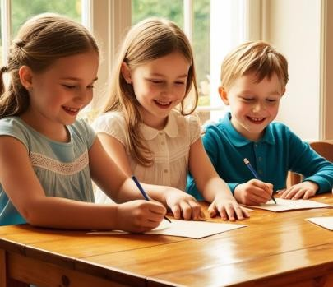
English
In our English lessons, we will be developing our stamina for writing longer pieces this half term. We will be using all the SPaG elements that we have learned this year in our writing. The children will be writing a range of fiction and non-fiction pieces this half term and will be writing a letter to their Year 2 teacher.
Mathematics
The children will be learning about place value to 100, how to measure mass and volume, how to calculate simple money and how to tell the time to the hour and half hour.
Physical Education
Our PE lessons will be twice a week on a TUESDAY and FRIDAY this half term. Children will need to come to school wearing their PE kit which consists of:
Year 1
Summer 2
Plain navy blue t-shirt with or without the school logo (no branded logos)
Plain black shorts, leggings or cycle shorts (no branded logos)
Plain black tracksuit bottoms (no pattern, branded logos etc)
Plain navy-blue sweatshirt (no hood, no pattern, no branded logos)
Plain black trainers that are suitable for outdoor sport. All soles and logos must be black.
Sun cream when the weather is warm
Sun hat
Computing
Throughout this half term, we will be learning how to create an algorithm and how to use the ipads to input an algorithm. The children will learn how to de-bug an algorithm. We will also learn about e-safety and how to stay safe when using the internet in school and at home.
PSHE
In PSHE, we will be focusing on transition. The children will be learning about what happens when they move to Year 2, where they will keep their belongings, who their teacher will be and they will be setting themselves some targets of things that they would like to learn or a skill they would like to develop in Year 2.
Please label all clothes clearly with
your child’s name.

Slide 2

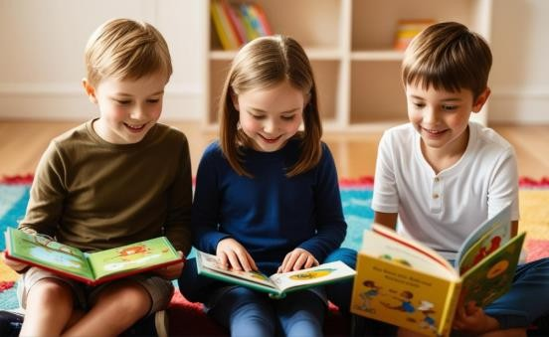

Library
Our library day will be on a Wednesday. If children wish to change their book then they can bring it on a Wednesday morning along with their book mark and hand it to Mrs Millington. They are welcome to keep their book for more than one week. Levelled reading books will also be changed on a Wednesday. Please continue to listen to your child read at least 3 times a week.
Uniform Expectations: We will continue to uphold expectations for school uniform, including:
A navy blue jumper or cardigan with or without the school logo; grey trousers, skirt or shorts; white or navy-blue polo shirt with or without the school logo; navy and white checked summer dress, plain white, grey or black socks or plain grey tights; Plain black pumps, trainers or school shoes to be worn inside the school building. Shoes with coloured laces or soles will not be accepted.
Please also ensure that all hair accessories are in line with the school uniform colours. Nail varnish, jewellery and watches are not permitted.
History
Throughout this half term, we will be learning about the Victorian Era. This will include learning about what life was like for children during this time, significant people – Florence Nightingale and Grace Darling, learning how to compare the differences and similarities between the Victorian Era and Present Day. We will also visit Cannon Hall Museum on Tuesday 23rd June – details for this have been sent via Ping.
As the weather gets warmer, please apply suncream before school and send a sun hat that is clearly labelled with your child’s name.

Slide 3

Drama-
Children are learning how to build positive friendships by understanding what makes a good friend and valuing others for who they are. Through drama activities, they explore ways to support one another through kindness and companionship, while developing key social skills such as sharing, taking turns, listening, and patience. They also learn that feeling lonely is normal, to respect similarities and differences between people, to recognise fair and kind behaviour, and to understand the importance of rules, as well as the difference between safe and unsafe secrets.
Outdoor Learning
This term, the children will be taught outdoor learning by Mrs Townend. This will be on a Wednesday afternoon. The children will need a sun hat if the weather is nice and if the weather is wet then they will need a raincoat. This lesson takes place in Walt’s Wood within the school grounds.
Music
In Music, the children will be learning about dynamics. They will listen to a range of musical pieces and explore how changes in volume can create different moods and meanings.
The children will also have the opportunity to create their own musical soundscapes, linked to our seaside theme, to reflect these moods. For example, they may choose sounds that represent crashing waves, the wind blowing along the shore, or a gentle sea breeze.
Spanish
In Spanish, we will be learning how to say and recognise the names of pets.

